Slide 1
Chemical Engineering: the next twenty years
Al Sacco, Jr.
George A. Snell Distinguish Professor of Engineering
Northeastern University
Boston, MA 02115

Slide 2
Where have we been, where are we going and What have we learned ???
?????

Slide 3
A little Prehistory* context on the development of Chemical Engineering
1880: George Davis proposes a "Society of Chemical Engineers" in England.
1881: Billy "the Kid" is shot by Pat Garrett.
1881: Louis Pasteur gave a public demonstration of the effectiveness of his anthrax vaccine.
1883: Osborne Reynolds published his paper on the Reynolds' Number, a dimensionless quantity which characterizes laminar and turbulent flow by relating kinetic (or inertial) forces to viscous forces within a fluid.
1888: George Davis provides the blueprint for a new profession as he presents a series of 12 lectures on Chemical Engineering in Manchester, England.
1888: Jack "the Ripper" kills six women in London.
1888: The Massachusetts Institute of Technology begins "Course X" (ten), the first four year Chemical Engineering program in the United States.
1892: Pennsylvania begins its Chemical Engineering curriculum.
1893: Sorel published "La rectification de l'alcool" were he developed and applied the mathematical theory of the rectifying column for binary mixtures. William Ostwald proved that enzymes are catalysts.
1894: Tulane begins its Chemical Engineering curriculum.
* www:pafko.com/history/h_time.html Copyright 2000, Wayne Pafko

Slide 4
A little Prehistory* perspective Chemical Engineering-continued
1895: Linde develops his process for liquefying air.
1895: The first professional US football game is played in Pennsylvania.
1898: The US defeats Spain in the Spanish-American War.
1899: The first bottle of Aspirin goes on sale to the public.
1901: George Davis publishes a “Handbook of Chemical Engineering.”
1903: Orville & Wilbur Wright fly the first powered aircraft at Kitty Hawk, North Carolina.
1903: The Ford Motor Company is founded.
1905: Einstein has his "miracle year" as he formulates the Special Theory of Relativity, establishes the Law of Mass-Energy Equivalence, creates the Brownian Theory of Motion, and formulates the Photon Theory of Light.
1906: The San Francisco Earthquake kills hundreds and destroys the city.
1908: The American Institute of Chemical Engineers (AIChE) is founded
* www:pafko.com/history/h_time.html Copyright 2000, Wayne Pafko

Slide 5
How are the practitioners being trained?

Slide 6
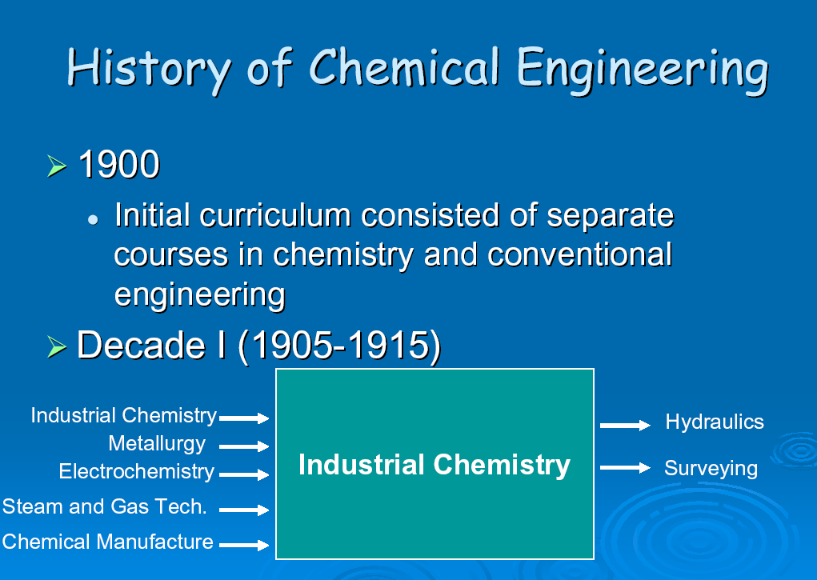
Esin Gulari, Division Director Chemical and Transport Systems, NSF WPI 2004

Slide 7
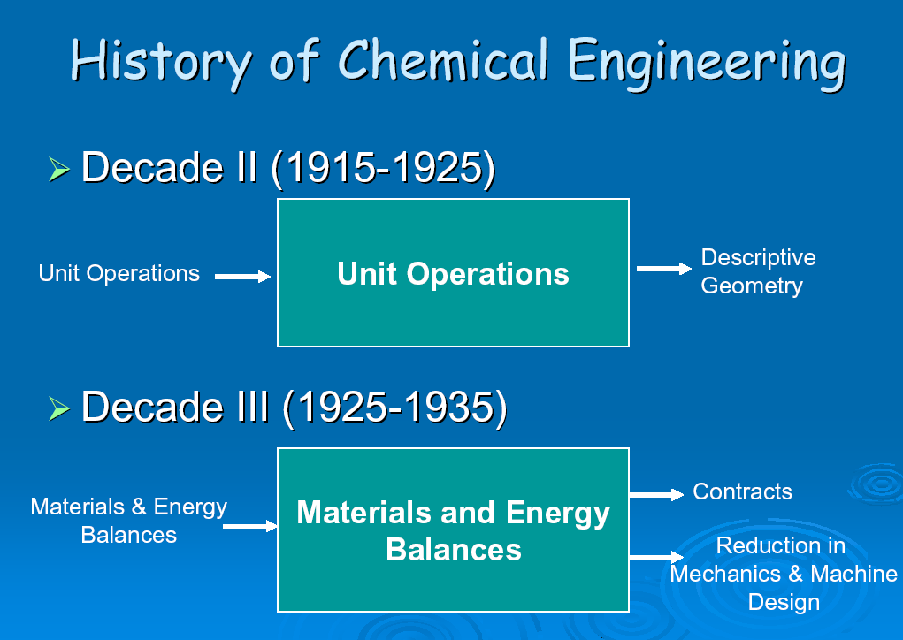
Esin Gulari, Division Director Chemical and Transport Systems, NSF WPI 2004

Slide 8
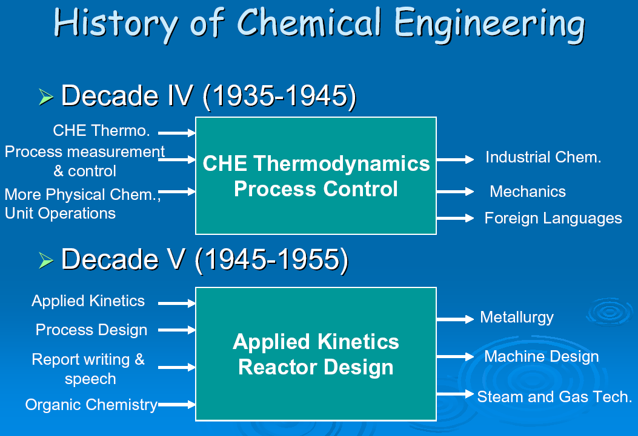
Esin Gulari, Division Director Chemical and Transport Systems, NSF WPI 2004

Slide 9
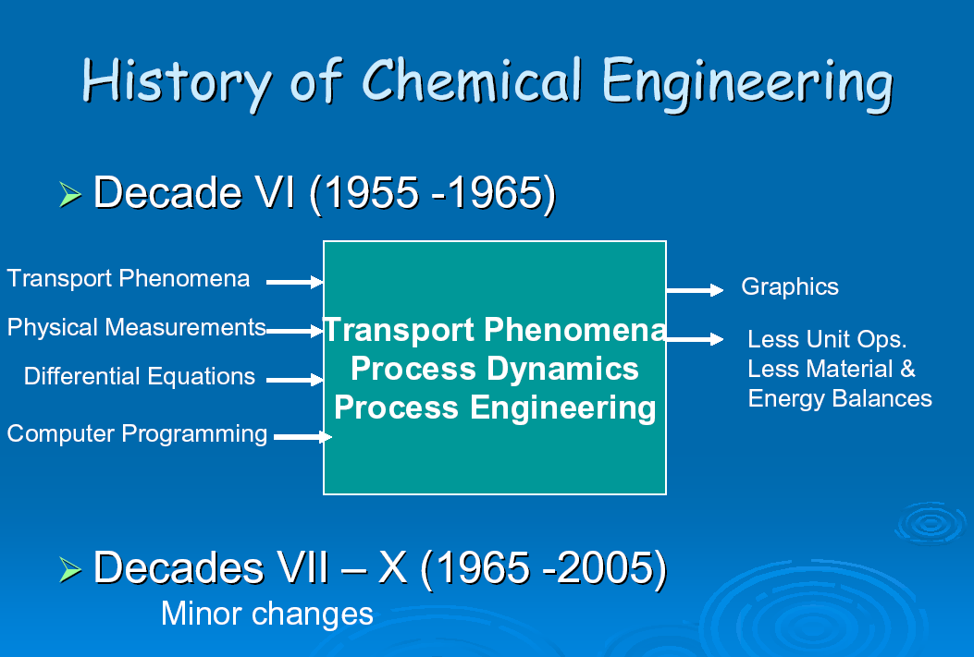
Esin Gulari, Division Director Chemical and Transport Systems, NSF WPI 2004

Slide 10
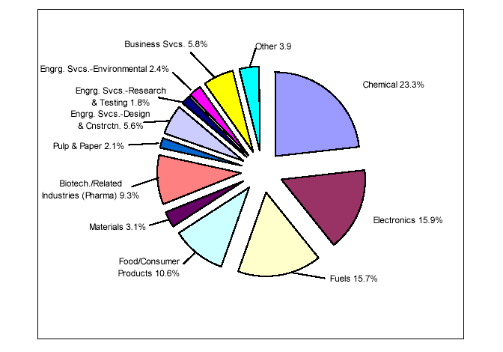
Industrial employment of B.S. chemical engineers starting in 2001
(AIChE Career Services, 2001)

Slide 11
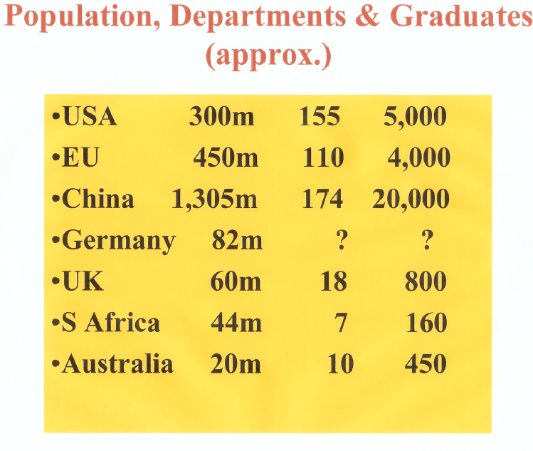
David Wood, "The Changing face of Chemical Engineering Education world-wide“
Northeastern University 2005

Slide 12
Now: Where are the emerging jobs for chemical engineers ?
Biotechnology emerging into a “real”commercial activity
Biomedical devices are beginning to emerge into the market place
MEMS devices going commercial
Nano technology……looking for applications
Advanced materials including: bi functional materials, conducting polymers, bio materials (e.g., tissue engineering) continue development for specialized applications
“Traditional” Petroleum and fine chemicals a mature industry. Activities going off shore

Slide 13
Questions: Where are the emerging areas in which chemical engineers will find employment in the next 20 years ?
Biotechnology will develop further
Biomedical devices including nano bio medical imagers, Customized pharmacy on a chip will emerge into the market place
NEMS devices go commercial
Advanced materials including: bi functional materials, conducting polymers, bio materials (tissue engineering) continue development for specialized applications
Bio-MEMs and Bio-NEMS emerge
in early commercial success.

Slide 14
What is likely to be the next technology “wave” given:
Integrated world (“internet”)
Energy availability continues to be a concern
Competition in all sectors becomes global
China becomes dominant “heavy” industrial power
India becomes dominant technical service provider

Slide 15
Result: “Western” Commercial Requirements/Needs “Innovation”
On going requirements:
A device/system should “use no power, have little or no volume and have no mass”
{ Nano/Microtechnology
New emphasis:
Additionally a device/system must
“be sustainable” That is, be “self-
sustaining and self-repairing”
Needs to be able to take care of
itself and live of the existing
environment
{ Biological systems
Synthesis: Integrated Biological/Physical Platforms

Slide 16
The Future of Chemical Engineering:
“Integrated Nano/Biological Platforms and the associated ability to rapidly manufacture these devices for specific, custom applications”

Slide 17
The Vision ……..
“…the formation of specialized devices to lower volume,weight, power requirements, while achieving loog term sustainability. This technology will lead to highly specific, sensitive, self-repairing and self-calibrating biological/physical systems (i.e., Bio-MEMS/NEMS).
………The integration of these technologies will create, in effect, an integrated assembly that will, in many cases, become incorporated into and “live” off its environment, while performing a service, needing almost no volume, minimum power and little-to-no servicing.”

Slide 18
Strengths, Weaknesses Opportunity and Threats (SWOT) analysis

Slide 19
Strengths……
Chemical Engineers have the broad mathematics
and science background to take the leadership position
Chemical Engineers have the transport background
Chemical Engineers have the design background
Chemical Engineers have the ability to lead and
contribute to interdisciplinary teams
Chemical Engineers in the past have shown the ability to
adapt

Slide 20
Weakness…….
Chemical Engineers will need to establish themselves
as leader in this area (unlike environmental/ bio/ Nano)
Chemical Engineers need to reshape their curriculum to
strategically position themselves for innovation and change
Chemical Engineers and ABET needs to allow flexibility and
change
Chemical Engineers must look at design in new ways
(e.g, factories on a chip, nano medical delivery systems
for customized medicine, etc)
Chemical Engineers need to reestablish dominance in
innovation

Slide 21
Opportunities….
Chemical Engineering becomes first to “molecular engineer
and molecular design”
Chemical Engineers maintain their broad base..just broaden!
Chemical Engineering job market stabilizes and broadens
Chemical Engineers will again be at the cutting edge not
following or just one of the crowd
Chemical Engineers will drive “western commercial activities”,
while developing designs, processes, and strategies for sustainable
and environmentally sound products

Slide 22
Threats…….
Paralysis by analysis
Unwillingness to change
Lack of ABET acceptance, and acceptance in a timely manner
Direction is not correct
Other Disciplines move more quickly and Chemical Engineers
are again following
Disciplinary arrogance

Slide 23
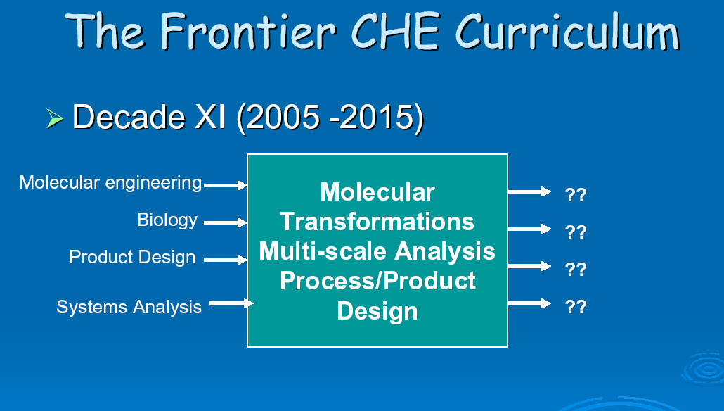
Nano structures
& architectures
Esin Gulari, Division Director Chemical and Transport Systems, NSF WPI 2004

Slide 24
? Will Molecular Engineering or
Molecular and Biomolecular Engineering more aptly be described what the profession does in the 21st century?

Slide 25
“In the beginning of a change, the patriot is a scarce man, and brave and hated and scorned. When his cause succeeds, the timid join him, for then it cost nothing to be a patriot.” Mark Twain

Slide 26
What do YOU think?????

